Slide 1
Credit Card Spending Habits In India
Microsoft SQL Server
Ramesh Kumar M
LinkedIn
Github

Slide 2
Dataset
This dataset contains insights into a collection of credit card transactions made in India, offering a comprehensive look at the spending habits of Indians across the nation
Dataset:
credit_card_dataset

Slide 3
Exploring the dataset
SELECT * FROM credit_card_transactions;
-- Viewing all the columns
SELECT COUNT(transaction_id) FROM credit_card_transactions;
-- Totally 26052 transactions
SELECT COUNT (DISTINCT city) FROM credit_card_transactions;
--There are 986 cities
SELECT MIN(transaction_date) AS first_date,MAX(transaction_date) AS end_date FROM credit_card_transactions
-- Transactions happened between 2013-10-04 AND 2015-05-26
SELECT DISTINCT card_type FROM credit_card_transactions;
-- Card types - Platinum, Gold, Signature, Silver
SELECT exp_type FROM credit_card_transactions GROUP BY exp_type
-- Expense types - Entertainment,Food, Bills,Fuel, Travel,Grocery
SELECT DISTINCT gender FROM credit_card_transactions;
-- Genders - Male and Female

Slide 4
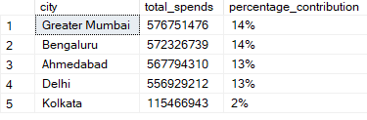
Top 5 cities with highest spending and their percentage contribution of total credit card spend
-- Query
WITH city_spend AS (
SELECT city, SUM(amount) AS total_spends
FROM credit_card_transactions
GROUP BY city
), total_spend AS (
SELECT SUM(cast(amount AS BIGINT)) AS total_amount
FROM credit_card_transactions
)
SELECT TOP 5 city_spend.*,
CONCAT(FLOOR(100*((total_spends*1.0)/total_amount)), '%')
AS percentage_contribution FROM
city_spend, total_spend
ORDER BY city_spend.total_spends DESC;

Slide 5
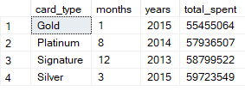
Highest spend month and amount spent in that month for each card type
-- Query
WITH highest_spend_month AS (
SELECT card_type, YEAR(transaction_date) AS years,
MONTH(transaction_date) AS months, SUM(amount)
AS total_spent
FROM credit_card_transactions
GROUP BY card_type, YEAR(transaction_date),
MONTH(transaction_date)
)
SELECT card_type,months,
years, total_spent FROM
(SELECT *, ROW_NUMBER() OVER(PARTITION BY card_type
ORDER BY total_spent DESC) AS rn
FROM highest_spend_month) a
WHERE rn = 1;

Slide 6
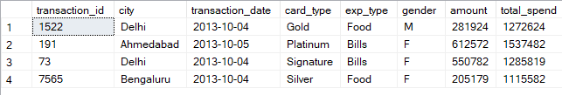
Transaction details for each card type when it reaches a cumulative of 1000000 total spends
-- Query
WITH transaction_details AS (
SELECT *, SUM(amount) OVER (PARTITION BY card_type ORDER BY
transaction_date,transaction_id) AS total_spend
FROM credit_card_transactions
)
SELECT *
FROM (SELECT *, ROW_NUMBER() OVER (PARTITION BY card_type
ORDER BY total_spend) AS rn
FROM transaction_details
WHERE total_spend >= 1000000) a
WHERE rn = 1;

Slide 7
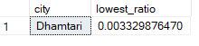
The city which had the lowest ratio spent on gold card type
-- Query
WITH cities AS (
SELECT city, card_type, SUM(amount) AS total_amount,
SUM(CASE WHEN card_type='Gold' THEN amount ELSE 0 END) AS amount_gold
FROM credit_card_transactions
GROUP BY city, card_type
)
SELECT TOP 1 city,
SUM(amount_gold)*1.0/SUM(total_amount) AS lowest_ratio
FROM cities
GROUP BY city
HAVING SUM(amount_gold) > 0
ORDER BY lowest_ratio ASC;

Slide 8
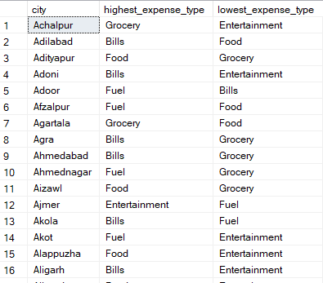
City, Highest Expense Type, Lowest Expense Type
-- Query
WITH city_expense AS (
SELECT city, exp_type,
SUM(amount) AS total_amount
FROM credit_card_transactions
GROUP BY city,exp_type
)SELECT city, MIN(CASE WHEN rn_desc=1 THEN exp_type END)
AS highest_expense_type, MAX(CASE WHEN rn_asc=1 THEN exp_type END)
AS lowest_expense_type
FROM (SELECT *,
ROW_NUMBER() OVER(PARTITION BY city ORDER BY total_amount DESC) AS rn_desc,
ROW_NUMBER() OVER(PARTITION BY city ORDER BY total_amount ASC) AS rn_asc
FROM city_expense) A
GROUP BY city;

Slide 9
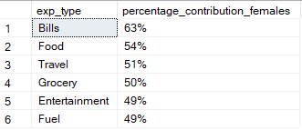
Percentage contribution of spending by females for each expense type
-- Query
SELECT exp_type
,CONCAT (FLOOR(SUM(CASE WHEN gender='F' THEN amount
ELSE 0 END)*1.0/SUM(amount)*100),'%') AS percentage_contribtion_females
FROM credit_card_transactions
GROUP BY exp_type
ORDER BY percentage_contribution_females DESC;

Slide 10

Card and Expense type combination which saw the highest month-over-month growth in Jan-2014
-- Query
WITH card_expense AS (
SELECT card_type, exp_type, YEAR(transaction_date) AS years,
MONTH(transaction_date) AS months, SUM(amount) AS total_amount
FROM credit_card_transactions
GROUP BY card_type, exp_type, YEAR(transaction_date), MONTH(transaction_date)
), combination AS (
SELECT *, LAG(total_amount) OVER (PARTITION BY
card_type, exp_type ORDER BY years,months) AS prev_amount FROM card_expense
)
SELECT TOP 1* FROM (SELECT *,((total_amount - prev_amount)*1.0/prev_amount)
AS month_over_month_growth FROM combination) a
WHERE years = 2014 AND months = '01’ AND prev_amount IS NOT NULL
ORDER BY month_over_month_growth DESC;

Slide 11
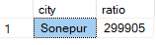
The city which has the highest total spend to total no. of transactions ratio during weekends
-- Query
SELECT TOP 1 city,
SUM(amount)/COUNT(*) AS ratio
FROM credit_card_transactions
WHERE DATENAME(WEEKDAY, transaction_date)
IN ('Saturday','Sunday')
GROUP BY city
ORDER BY ratio DESC;

Slide 12
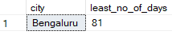
The city that took the least number of days to reach its 500th transaction after the first transaction in that city
-- Query
WITH total_transactions AS (
SELECT *, ROW_NUMBER() OVER(PARTITION BY city ORDER BY transaction_date) AS rn
FROM credit_card_transactions
)
SELECT TOP 1 * FROM (SELECT city,
DATEDIFF(DAY,MIN(transaction_date),MAX(transaction_date)) AS least_no_of_days
FROM total_transactions
WHERE rn=1 OR rn=500
GROUP BY city) a
WHERE least_no_of_days >0
ORDER BY least_no_of_days ASC;

Slide 13
THANK YOU
Ramesh Kumar M
LinkedIn
Github

